Slide 1
Migrating to ‘C’

Slide 2


Why did We Learn Python?
Easy to learn
Language with simple rules
Good for beginners
Code is readable
Less development time
No memory management
Great support for building web apps
Dynamic language and no type checking

Slide 3

Limitations of Python
Python is not a good choice for:
Memory intensive and computation intensive tasks
Embedded Systems where processor has limited capacity
For graphic intensive 3D game that takes up a lot of CPU
Applications that demand concurrency and parallelism
Developing mobile apps
Design restrictions
Interpreted language and is slow compared to C/C++ or Java

Slide 4
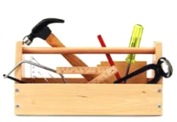
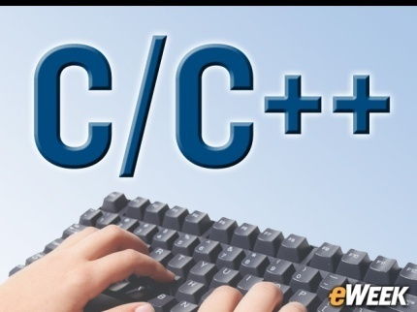
Why to learn more languages?
Similar to why a carpenter has more than just a hammer in his/her toolbox
Every programming language has its positive and negative points
One language cannot do everything
That is why there are many languages; some are fantastic for some things
Eg: C/C++ is typically the benchmark for speed and memory usage, and some languages provide strengths elsewhere (Eg: Python is very easy to pick up)

Slide 5

Transiting from Python to C/C++
Will not be so hard
There are quite a few syntax differences between the two languages
Only way to learn a new programming language is by writing programs in it
Dennis Ritchie

Slide 6

History of C
Born at AT & T Bell Laboratory of USA in 1972
Many of C’s principles and ideas were derived from the earlier language B
Ken Thompson was the developer of B Language
C was written by Dennis Ritchie
http://www.nytimes.com/2011/10/14/technology/dennis-ritchie-programming-trailblazer-dies-at-70.html?_r=0
C language was created for a specific purpose i.e designing the UNIX operating system (which is currently base of many UNIX based OS)
Quickly spread beyond Bell Labs in the late 70’s because of its strong features

Slide 7

About Dennis Ritchie
Born September 9, 1941
Known for ALTRAN, B, BCPL, C, Multics, Unix
Won Turing Award in 1983
Developed C language which is widely used developing, operating systems, compiler, and embedded system development, Assemblers, Text editors, Print Spoolers, Network drivers databases etc and its influence is seen in most modern programming languages
Died on October 12, 2011

Slide 8

Features of C language
Portability - C Programs can run on any compiler with little or no modification
Low level features: C provides low level features and is closely related to lower level assembly Languages(DOS operating systems, the Turbo Pascal compiler)
Modular programming - software design technique that increases the extent to which software is composed of separate parts, called modules
Has many successor languages which are designed to look like C, e.g., C++, C#, Objective-C, Java, JavaScript, PHP and Perl.

Slide 9

C is a structured programming language
Divides the large problem in to smaller modules called functions or procedures
Each function or module handles the particular task and the collection of all the functions is called a program, which solves the large problem
Easier to modify and debug

Slide 10
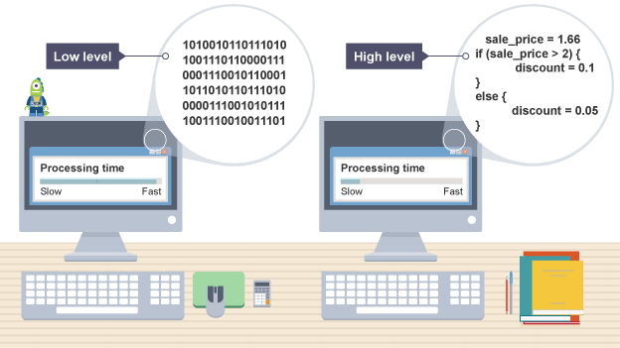
Difference between Python and C
C programs – Compiled
Python programs – Interpretered
Compiler | Interpreter
Takes entire program as input and generate a output file with object code | Takes instruction by instruction as input and gives an output. But does not generate a file
Errors are displayed after entire program is checked | Errors are displayed for every instruction interpreted (if any)

Slide 11
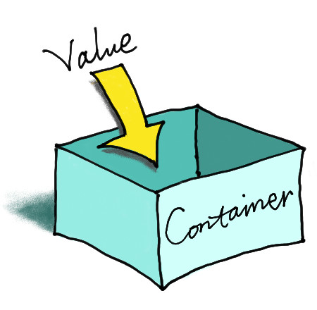
Variable Declaration in C
In C, it is mandatory to do variable declaration
We say variable's type, whether it is an integer (int), floating-point number (float), character (char) etc
Syntax is type of variable, white space, name of variable semicolon
Eg: int number;

Slide 12
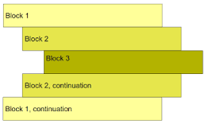
Intendation
Block of code in C need not be intended as in Python
In C, Curly braces are used for giving a block of code Eg: Block of code in ‘C’
{
-----
}

Slide 13
Problem
Little Bob loves chocolate, and he goes to a store with Rs. N in his pocket. The price of each chocolate is Rs. C. The store offers a discount: for every M wrappers he gives to the store, he gets one chocolate for free. This offer is available only once. How many chocolates does Bob get to eat?

Slide 14
PAC For Chocolate Problem
Input | Processing | Output
Amount in hand, N Price of one chocolate, C Number of wrappers for a free chocolate, M | Number of Chocolates P = Quotient of N / C Free chocolate F = Quotient of P/M | Total number of chocolates got by Bob

Slide 15
Pseudocode
READ N and C
COMPUTE num_of_chocolates as N/C
CALCULATE returning_wrapper as number of chocolates/m
TRUNCATE decimal part of returning_wrapper
COMPUTE Chocolates_recieved as num_of_chocolates + returning_wrapper
PRINT Chocolates_recieved

Slide 16
Knowledge Required
Following knowledge is required in C to write a code to solve the above problem
Read input from user
Data types in C
Perform arithmetic calculations
Write output

Slide 17
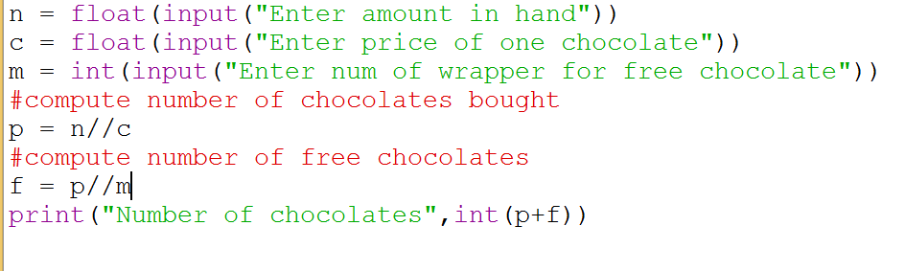
Python Program for Bob Problem

Slide 18
Layout of a C program
pre-processor directives – Preceded by a ‘#’
global declarations – Optional
int main() - standard start for all C programs
{
local variables to function main ; - all variables used in the function must be declared in the beginning
statements associated with function main ;
}
void f1()
{
local variables to function 1 ;
statements associated with function 1 ;
}

Slide 19
Components of a C program
A C program consists of the following parts:
Comments
Variables
Preprocessor Commands
Functions
Statements & Expressions

Slide 20
Comments in C
Two types of comments
Single line and multi line comment
Single Line Comment is double forward slash ‘//’ and can be Placed Anywhere

Slide 21
Multiline Comments in C
Multi line comment can be placed anywhere
Multi line comment starts with /*
Multi line comment ends with */
Any symbols written between '/*’ and '*/‘ are ignored by Compiler

Slide 22
Data types in C
Basic Arithmetic types - further classified into: (a) integer types and (b) floating-point types
Enumerated types - arithmetic types that are used to define variables that can be assigned only certain discrete integer values throughout the program
Type void - indicates that no value is available
Derived types - They include (a) Pointer types, (b) Array types, (c) Structure types, (d) Union types and (e) Function types

Slide 23
Broad Classification of Data Types
Numerical data types are broadly classified into
Signed
Unsigned
Signed can store zero, positive and negative values
Unsigned can store only zero and positive values
Some applications use unsigned data types only Eg: age

Slide 24
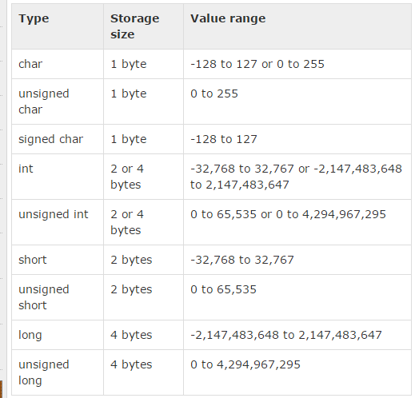
Integer Types

Slide 25
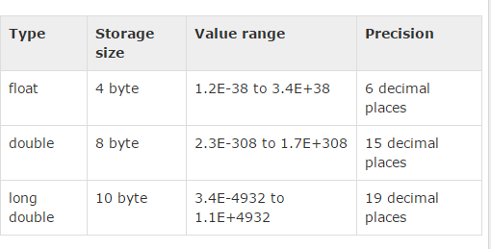
Floating Point Types

Slide 26
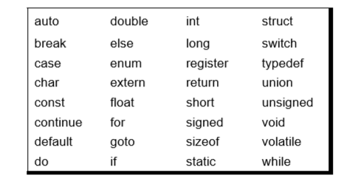
Keywords
32 keywords available in C
Compiler vendors (like Microsoft, Borland, etc.) provide their own keywords

Slide 27
Discuss Valid and Invalid variable names
BASICSALARY
_basic
basic-hra Invalid
#MEAN Invalid
group. Invalid
422 Invalid
population in 2006 Invalid
FLOAT
hELLO
Notes:
Invalid----basic-hra, #MEAN ,group.
422 ,population in 2006

Slide 28
I/O in C
Basic operation in any language
Input is got through a function scanf which is equivalent to input or raw_input in Python
Scanf has two or more arguments
First format string, followed by address of variables that are going to hold values entered by user

Slide 29
I/O in C
printf contains one or more arguments
first argument is the format string

Slide 30
printf and scanf format codes
code | type | format
d | int | decimal (base ten) number
o | int | octal number (no leading '0' supplied in printf)
x or X | int | hexadecimal number (no leading '0x' supplied in printf; accepted if present in scanf) (for printf, 'X' makes it use upper case for the digits ABCDEF)
ld | long | decimal number ('l' can also be applied to any of the above to change the type from 'int' to 'long')

Slide 31
printf and scanf format codes
code | type | format
u | Unsigned int | decimal number
lu | unsigned long | decimal number
c | char | single character
s | char pointer | string
f | float | number with six digits of precision
lf | double | number with six digits of precision

Slide 32
Address of a variable
Address of a variable can be obtained by putting a ‘&’ before the variable name

Slide 33
Example 1
#include<stdio.h> void main() { int a = 27; int b = 25; int c = a -b; printf("%d",c); }

Slide 34
Output 1
2

Slide 35
Example 2
#include<stdio.h>
void main()
{
int a,b,c;
scanf("%d%d",&a,&b);
c=a+b;
printf("%d",c);
}

Slide 36
Output 2
Input:
2
3
Output:
5

Slide 37
Example 3
#include<stdio.h> void main() { char a = 27; char b = 25; char c = a -b; printf("%c",c); }

Slide 38
Output 3
A special character

Slide 39
Arithmetic Operators in C
Operator | Description
+ | Adds two operands
− | Subtracts second operand from the first.
∗ | Multiplies both operands
∕ | Divides numerator by denominator
% | Modulus Operator and remainder of after an integer division.
++ | Increment operator increases the integer value by one
-- | Decrement operator decreases the integer value by one

Slide 40
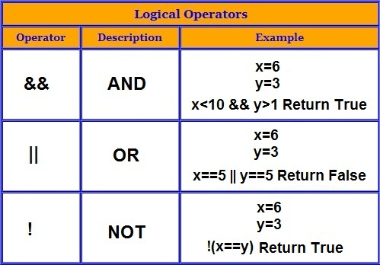

Slide 41
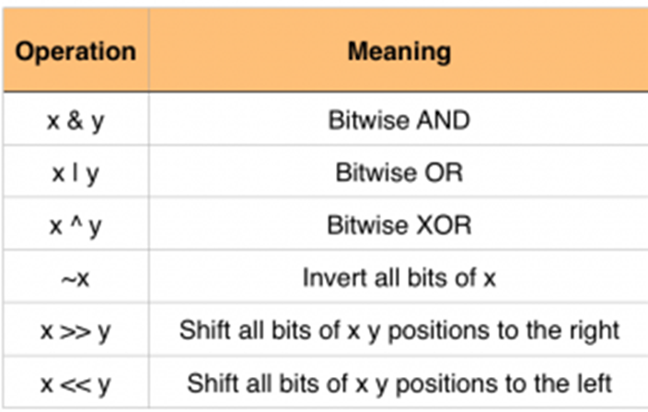

Slide 42
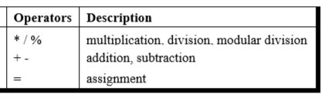
Precedence of Operators in C
++, -- Post increment Operators
++, -- Pre increment Operators
Parenthesis can be used to override default precedence

Slide 43
Example 4
#include<stdio.h> main() { int a, b,c; a = 4; b = 2; c = -a+--b; printf ( "c = %d", c) ; }

Slide 44
Output 4
c = -3

Slide 45
Example 5
#include<stdio.h> main() { int a, b,c; a = 4; b = 2; c = -a+ b--; printf ( "c = %d", c) ;
printf ( "b = %d", b) ; }

Slide 46
Output 5
c = -2
b = 1

Slide 47
Example 6
#include<stdio.h> main() { int a, b,c; a = 4; c = a++; printf ( "c = %d", c) ; printf ( "a = %d", a) ; }

Slide 48
Output 6
c = 4 a = 5

Slide 49
Example 7
#include<stdio.h> main() { int a, b,c; a = 4; c =++a; printf ( "c = %d", c) ; printf ( "a = %d", a) ; }

Slide 50
Output 7
c = 5 a = 5

Slide 51
Example 8
#include<stdio.h> main() { int a, b,c; a = 4; c = a++ + ++a; printf ( "c = %d", c) ; printf ( "a = %d", a) ; }
Notes:
c=4+6

Slide 52
Output 8
c = 10 a = 6

Slide 53
Associativity of Operators in C
When precedence of two operators are same then associativity of operator is considered for evaluation

Slide 54
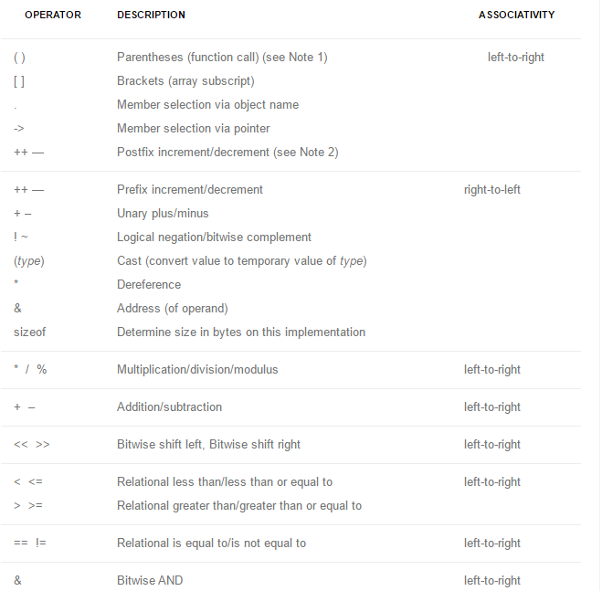

Slide 55
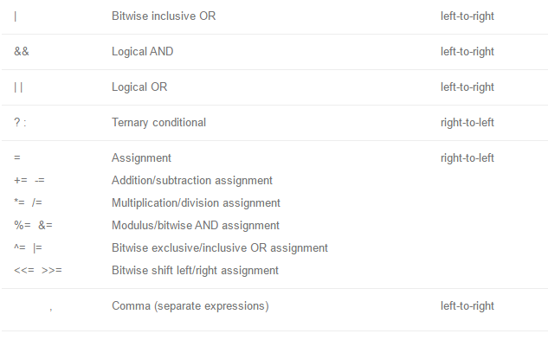

Slide 56
Automatic Type Conversion in C
Convert a variable from one data type to another data type
When the type conversion is performed automatically by the compiler without programmers intervention, such type of conversion is known as implicit type conversion or type promotion.
The compiler converts all operands into the data type of the largest operand.

Slide 57
Rules for Implicit Type Conversion in C
Sequence of rules that are applied while evaluating expressions are given below:
All short and char are automatically converted to int, then,
If either of the operand is of type long double, then others will be converted to long double and result will be long double.
Else, if either of the operand is double, then others are converted to double.
Else, if either of the operand is float, then others are converted to float.

Slide 58
Example 9
#include<stdio.h> void main() { char a = 65; char b = 100; char c = a%b; printf("%c",c); }

Slide 59
Output 9
A

Slide 60
Example 10
#include<stdio.h> void main() { int a = 165; int b = 100; int c = (float)a/b; printf("%d",c); }

Slide 61
Output 10
1

Slide 62
Example 11
#include<stdio.h> void main() { int a = 165; int b = 100; float c = a/b; printf("%f",c); }

Slide 63
Output 11
1.000000

Slide 64
Example 12
#include<stdio.h> void main() { float a = 165; float b = 100; float c = a/b; printf("%f",c); }

Slide 65
Output 12
1.650000

Slide 66
Example 13
#include<stdio.h> void main() { int a = 165; float b = 100; float c = a/b; printf("%f",c); }

Slide 67
Output 13
1.650000

Slide 68
Explicit Type Conversion
Type conversion performed by the programmer is known as explicit type conversion
Explicit type conversion is also known as type casting.
Type casting in c is done in the following form:
(data_type)expression;
where, data_type is any valid c data type, and expression may be constant, variable or an expression
For example, x=(int)a+b*d;

Slide 69
Explicit Type Conversion
The following rules have to be followed while converting the expression from one type to another to avoid the loss of information:
All integer types to be converted to float.
All float types to be converted to double.
All character types to be converted to integer.

Slide 70
Example 14
#include<stdio.h> void main() { int a = 165; int b = 100; float c = (float)(a/b); printf("%f",c); }

Slide 71
Output 14
1.000000

Slide 72
Example 15
#include<stdio.h> void main() { int a = 165; int b = 100; float c = (float) a/b; printf("%f",c); }
Notes:
Here b will be converted to float
if either of the operand is float, then others are converted to float.

Slide 73
Output 15
1.650000

Slide 74
Declaration and Definition of Variables in C
Declaration – Information to compiler about the variable
Definition – Memory is allocated for the variable according to type

Slide 75
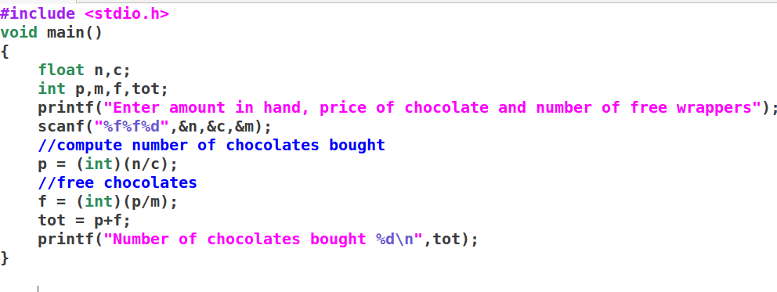
Notes:
float n,c;
Int p,m,f,tot;
Scanf(“%f%f%d”,&n,&c,&m);
P=n/c;
F=p/m
Tot=p+f;
Printf(“%d”,tot);

Slide 76
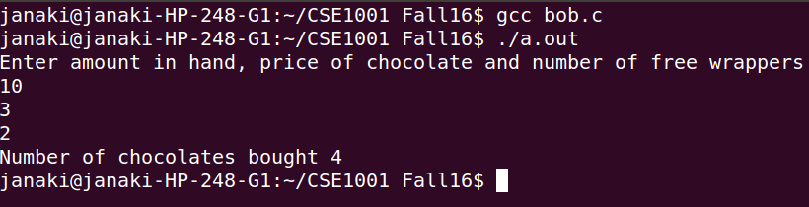

Slide 77
Problem
ABC company Ltd. is interested to computerize the pay calculation of their employee in the form of Basic Pay, Dearness Allowance (DA) and House Rent Allowance (HRA). DA and HRA are calculated as certain % of Basic pay(For example, DA is 80% of Basic Pay, and HRA is 30% of Basic pay). They have the deduction in the salary as PF which is 12% of Basic pay. Propose a computerized solution for the above said problem.
Input : Basic Pay
Process : Calculate Salary
( Basic Pay + ( Basic Pay * 0.8) + ( Basic Pay * 0.3 - ( Basic Pay * 0.12)
-----------allowances -------------- --- deductions----
Output : Salary

Slide 78
Problem
Find the average runs scored by a batsman in 4 matches
Area of a circle

Slide 79
Exercise
An university is setting up a new lab at their premises. Design an algorithm and write Python code to determine the approximate cost to be spent for setting up the lab. Cost for setting the lab is sum of cost of computers, cost of furnitures and labour cost. Use the following formulae for solving the problem:
Cost of computer = cost of one computer * number of computers
Cost of furniture = Number of tables * cost of one table + number of chairs * cost of one chair
Labour cost = number of hours worked * wages per hour

